Slide 1
Pass With a Trace
Jackson Warren

Slide 2
Original Goal
Security System designed to notify users when a room has been entered
Simple “trip” system run by a Raspberry pi
Sends notification to user

Slide 3
How we made it happen
Testing phase using Arduino and simple magnetic switch
Converting this logic to the ESP32
Connecting the ESP32 to the internet and sending a request to URL
Using IFTTT applet to text user

Slide 4
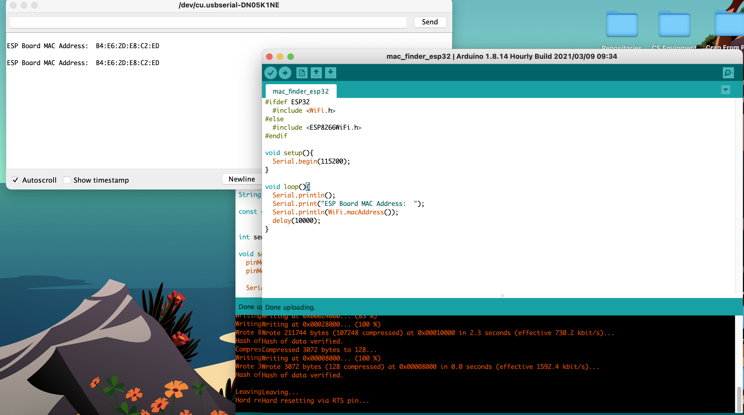
Connect to WiFi

Slide 5
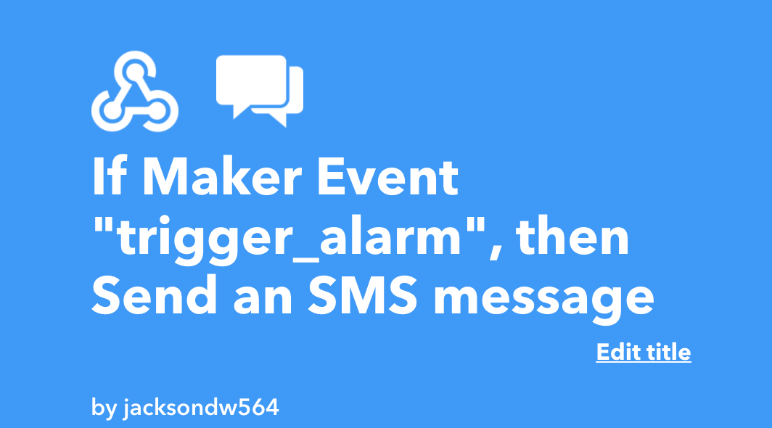
The Steps: IFTTT

Slide 6
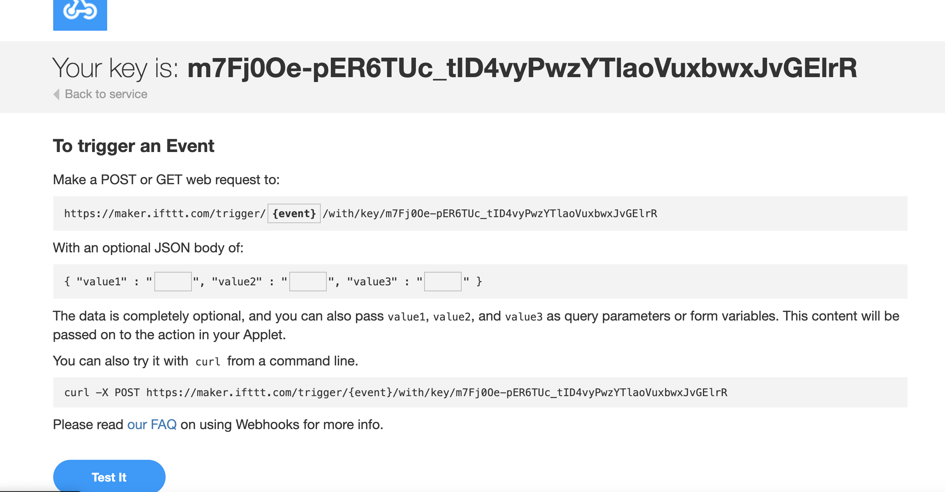
The Steps: WebHooks

Slide 7
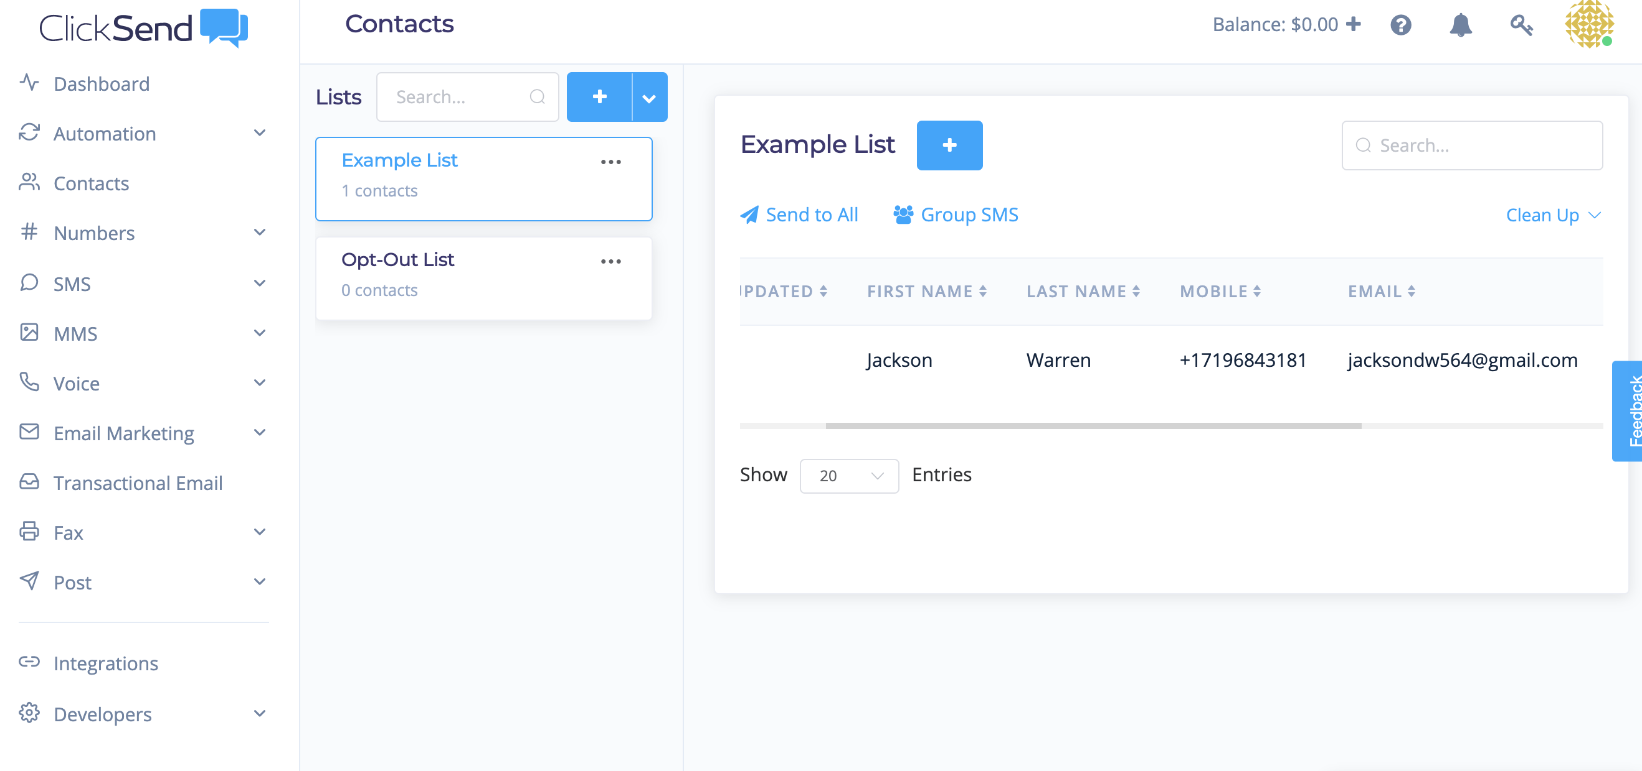
The Steps: ClickSend
Booooo, no good
$$$$$$$$$$$$$$

Slide 8

The Steps: Email (Text not working…)

Slide 9
The Code and Test it

Slide 10
Previous End Goals
Have a working product that can sense an interference with the system (such as a door opening).
Gain knowledge on how devices communicate
Understanding of approaching problems like this in a CS mindset.

